Slide 1
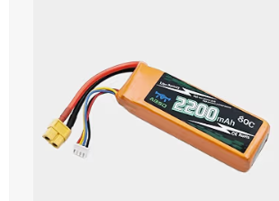
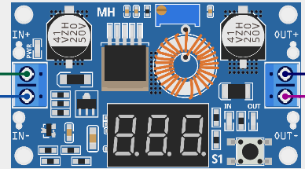
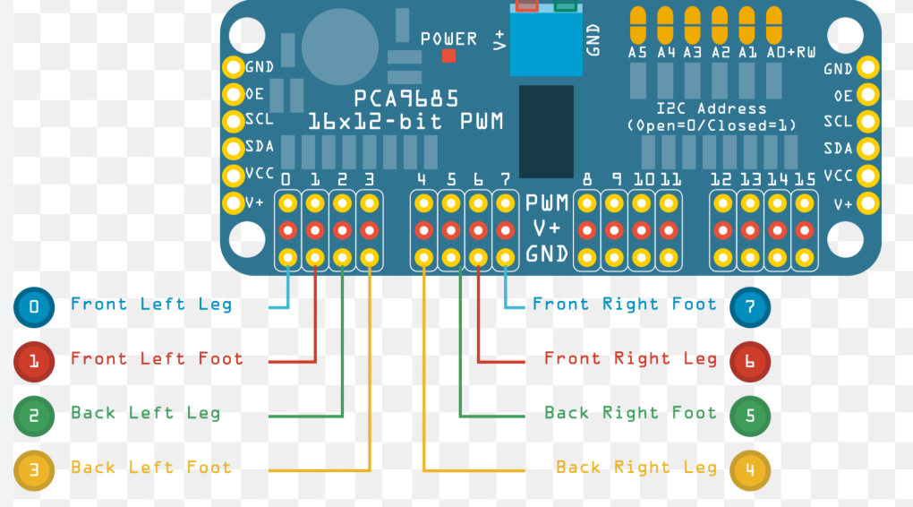
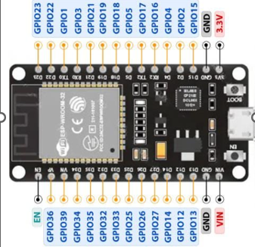
Schematics
PCA9685 16-Channel Servo Driver
XL4015 5A Buck Converter
LIPO battery 22mah 3s
ESP32 Development Board
From Source | Pin / Terminal | To Destination | Pin / Terminal | Purpose
3S LiPo Battery | Red Wire (+) | XL4015 Buck Converter | IN+ | Raw 11.1V Battery Input
3S LiPo Battery | Black Wire (-) | XL4015 Buck Converter | IN- | Battery Ground
XL4015 Output | OUT+ (Set to 6.0V) | PCA9685 Driver | Green Screw Terminal V+ | Servo Power Rail
XL4015 Output | OUT- (GND) | PCA9685 Driver | Green Screw Terminal GND | Motor Ground
XL4015 Output | OUT+ (Set to 6.0V) | ESP32 Expansion Board | VIN (or 5V) | Board Main Power
XL4015 Output | OUT- (GND) | ESP32 Expansion Board | GND | Shared System Ground
From Source (ESP32 Expansion Board) | Pin / Terminal | To Destination (PCA9685 Driver) | Pin / Terminal | Purpose
ESP32 Expansion Board | 3.3V | PCA9685 Driver | VCC | Logic Power for Driver IC
ESP32 Expansion Board | GND | PCA9685 Driver | GND | Shared Signal Ground
ESP32 Expansion Board | GPIO 21 | PCA9685 Driver | SDA | I2C Data Line
ESP32 Expansion Board | GPIO 22 | PCA9685 Driver | SCL | I2C Clock Line

Slide 2
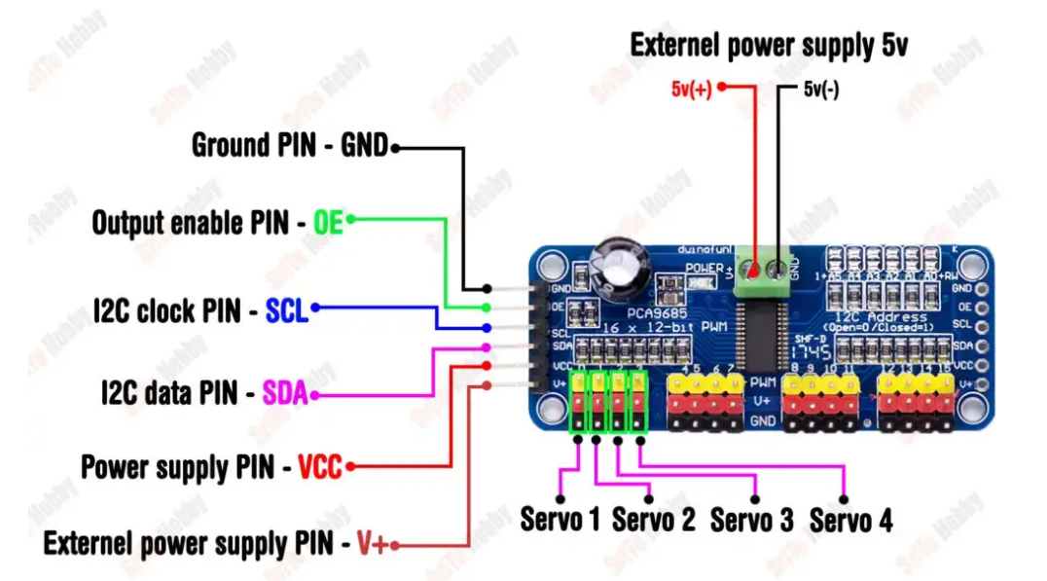
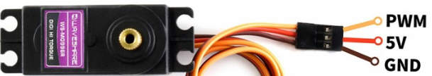
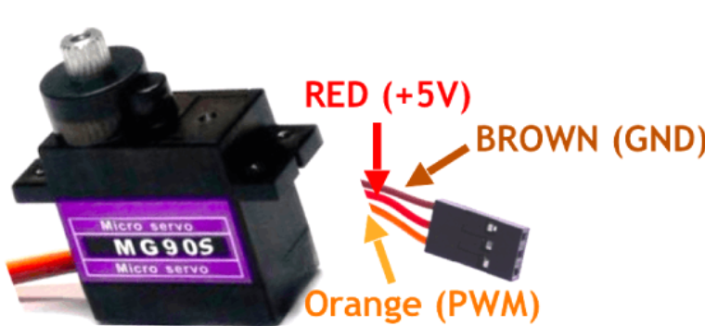
MG996R Metal Gear Servo Motor
MG90S Metal Gear Micro Servo Motor
MG90S Metal Gear Micro Servo Motor
MG90S Metal Gear Micro Servo Motor
MG996R Metal Gear Servo Motor
PCA9685 Channel | Wire Alignment | Connected Servo | Joint Control
Channel 0 | Yellow/Orange (PWM), Red (V+), Brown/Black (GND) | MG996R | Base Rotation
Channel 1 | Yellow/Orange (PWM), Red (V+), Brown/Black (GND) | MG996R | Shoulder Lift
Channel 2 | Yellow/Orange (PWM), Red (V+), Brown/Black (GND) | MG996R | Elbow Movement
Channel 3 | Yellow/Orange (PWM), Red (V+), Brown/Black (GND) | MG90S | Wrist Pitch
Channel 4 | Yellow/Orange (PWM), Red (V+), Brown/Black (GND) | MG90S | Gripper Actuation
Channel 5 | Yellow/Orange (PWM), Red (V+), Brown/Black (GND) | MG90S | Camera Mount / Spare Joint
MG996R Metal Gear Servo Motor

